Slide 1


Personality Prediction using MBTI Dataset
Name -
Harshit Patel
Ashish Srivastava
Divyanshu Chaudhary
Harsh

Slide 2

Personality Prediction Using the MBTI Dataset
Predict personality traits from text using machine learning and NLP techniques.
Leveraging the widely used Myers-Briggs Type Indicator for practical insights.

Slide 3

Introduction to MBTI
MBTI Overview
16 Personality Types
Self-report tool identifying psychological preferences across four dichotomies.
Examples include ISTJ, ENFP, each representing unique traits.
Applications
Used in career counseling, team building, development, and 80% of Fortune 500 companies.

Slide 4
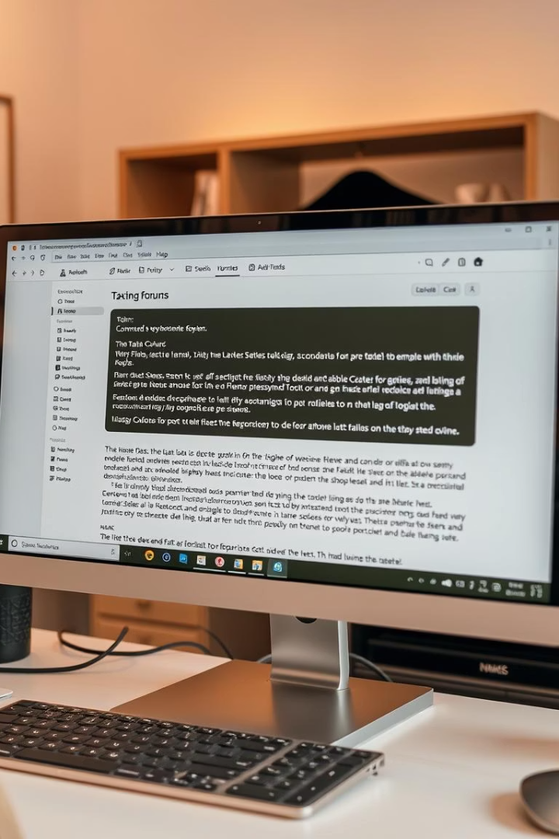
The MBTI Dataset
Source
Kaggle dataset: 8,600+ users, 50 recent posts each, from PersonalityCafe forum.
Preprocessing
URLs and mentions removed for clean text suitable for analysis.
Imbalance
Uneven representation across types; INFP notably abundant.
Example
"I'm an INFP and I love rainy days..." demonstrating personal style.

Slide 5
Methodology: Feature Extraction
Text Preprocessing
Vectorization
Context & Sentiment
Tokenization, stemming, and stop word removal to refine input.
Using TF-IDF and word embeddings for rich text representation.
N-grams capture word sequences; sentiment analysis reveals emotional tone.

Slide 6
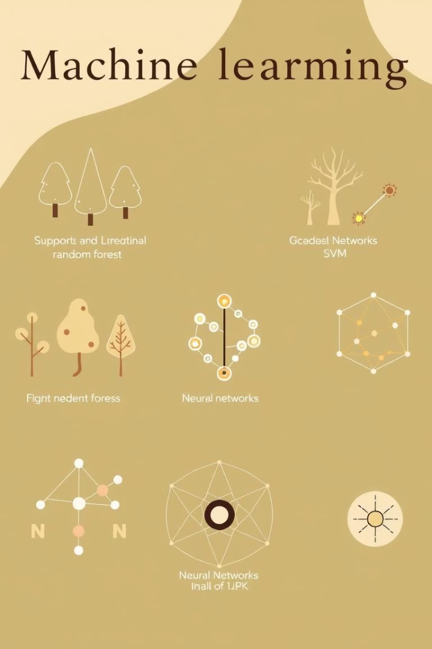




Methodology: Machine Learning Models
Naive Bayes
Support Vector Machines
Random Forest
Fast and effective baseline for text classification.
Reduces overfitting using ensemble learning.
Handles high-dimensional data with strong accuracy.
Neural Networks
Captures complex patterns via deep learning.

Slide 7
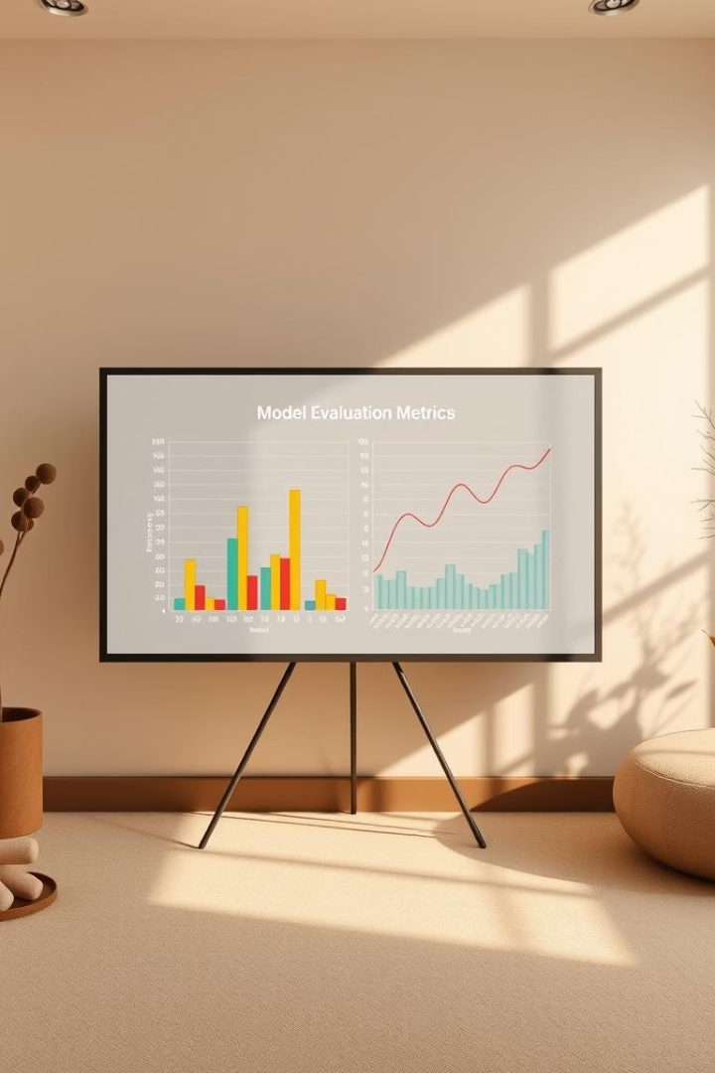
Performance Metrics
Accuracy
Overall prediction correctness (e.g., 70%)
Precision
Avoids false positives (e.g., 80% for INFP)
Recall
Identifies all instances (e.g., 65% for ENTP)
F1-score
Balance of precision and recall
Confusion Matrix
Visualizes classification errors and overlaps

Slide 8

Results and Analysis
Model Performance
SVM model led with 72% accuracy among tested algorithms.
Feature Insights
Key words like “creative” help identify specific personality types.
Error Patterns
Mistakes often occur between similar types like INTJ and INFJ.
Addressing Imbalance
Techniques like oversampling improve fairness and model bias.

Slide 9





Applications and Conclusion
Personalized Recommendations
Tailor career, education, and relationship advice by personality.
Targeted Marketing
Customize messaging based on predicted personality types.
Team Building
Create balanced groups for optimal collaboration and productivity.
Ethics & Future
Avoid stereotypes, incorporate multimodal data like audio and images.

